Slide 1
Research Paper Presentation
On
My Colony: Design and Evaluation of a
Colony-Based Digital Services Platform
Harshit Satija- harshit1633.be22@chitkara.edu.in
Anurag Thakur- anurag1321.be22@chitkara.edu.in
Avinash Sisodia- avinash1414.be22@chitkara.edu.in
Arnav Garg- arnav1348.be22@chitkara.edu.in
Supervised By : Mr Ajay Kumar
Department of Computer Science and Engineering,
Chitkara University, Punjab

Slide 2
Abstract
• Platform Overview My Colony is a web platform that connects housing colony residents with verified, colony-specific local service providers.
The platform addresses the lack of trusted, community-level service discovery in residential societies.
• Authentication & Access Control JWT-based authentication ensures secure, stateless user sessions across the platform.
Role-based access control (RBAC) differentiates residents, service providers, and administrators.
• Three-Tier MERN Stack React.js powers the frontend, delivering a responsive and intuitive user interface.
Node.js and Express.js form the backend, handling API logic and business rules.
• Platform Capabilities MColony-scoped listings ensure residents only discover services available within their community.
Multi-colony management allows the platform to scale across multiple societies freely.

Slide 3
Introduction
• Rise of Gated Communities Urban residential colonies face growing demand for everyday local services like maintenance, tutoring, and repairs.
Residents still rely on informal channels like WhatsApp groups and word-of-mouth to find providers.
• Problem with Informal Methods Informal networks lack structure and accountability, making provider verification and comparison difficult to make.
• Limitations of Existing Platforms
Platforms like UrbanClap and TaskRabbit are built for large-scale use, not colony- specific communities.
• Need for an Integrated Solution Existing platforms handle only isolated features — no single system combines governance, moderation, and discovery.

Slide 4
Research Objectives
Build a Hyperlocal Service Marketplace To develop a colony-specific platform where residents can list and discover services like tutoring, food, laundry, and maintenance within their community.
Implement Role-Based Trust Mechanisms To design an admin approval system and resident verification flow that ensures only trusted, verified service providers operate within the colony.
Address the Hyperlocal Trust Deficit To overcome the lack of verified, community-governed platforms by combining JWT authentication, admin oversight, and a review/rating system.
Provide Data-Driven Colony Insights To build an analytics dashboard that gives administrators visibility into service quality, pricing trends, category gaps, and community engagement.

Slide 5
Related Work
Feature | MyColony (Proposed) | Generic Marketplaces | Informal Channels
Trust Layer | Colony-Level Admin | Broad/Global | Personal Referrals
Verification | Role-Based/Colony-Specific | General Identity | None
Governance | Local Admin Moderation | Platform-wide | None
Analytics | For Colony Managers | For Providers | None
• This table presents a comparison between the proposed MyColony platform, generic marketplaces, and informal channels.
• Different platforms follow varying approaches to trust, verification, and governance.
• MyColony introduces a colony-level trust layer and role-based verification, unlike broader or unstructured systems.
• Governance in MyColony is managed locally by admins, while other platforms rely on centralized or no control.
• The platform also provides analytics for colony managers, offering better insights compared to limited or no analytics in other systems.

Slide 6
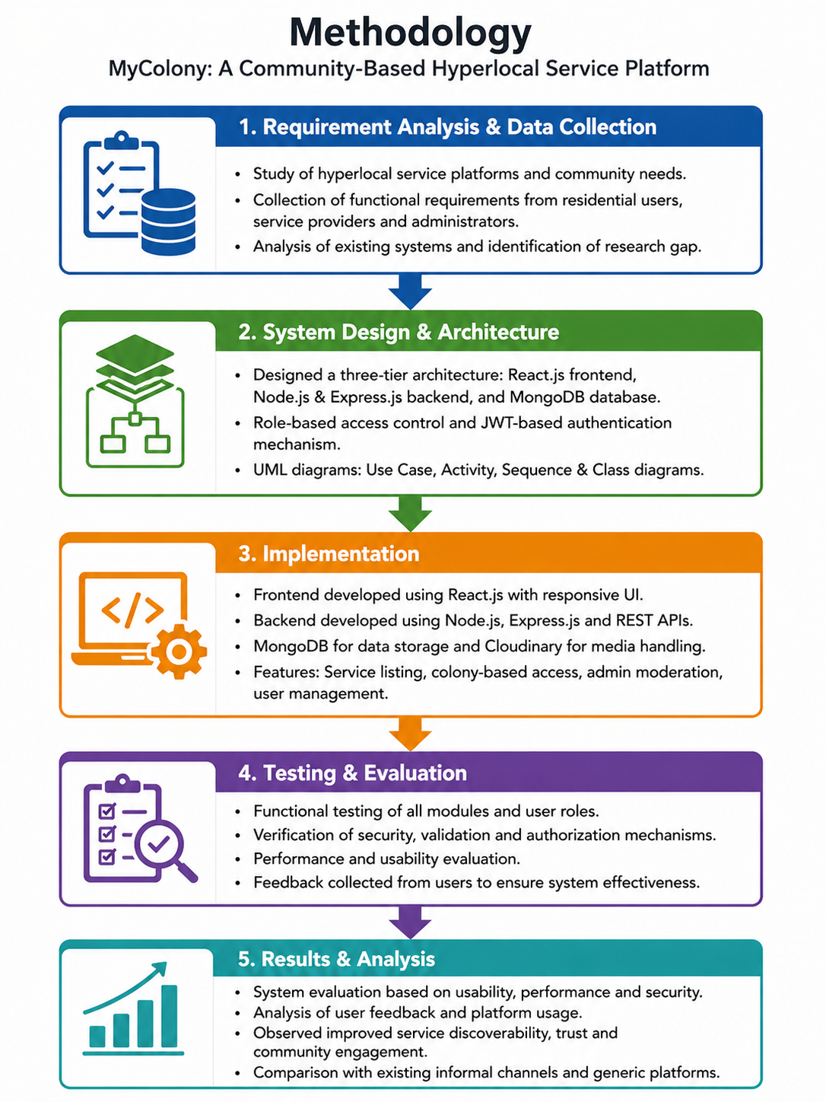
Methodology
Our methodology follows a step-by-step pipeline starting from data collection to model evaluation. Each step ensures better accuracy and reliability of predictions.

Slide 7
Datasets Used
• Primary Dataset Source
UCI Student Performance Dataset is used for analysis, providing structured academic and student-related data.
• Dataset Composition
The dataset contains around 649 student records with 33 attributes, covering demographic, academic, and behavioral information.
• Key Features Considered
Important variables include study time, attendance, parental education, and past grades, which significantly influence student performance.
• Target Variable
Final grade (G3) is used as the output variable, representing the overall academic performance of students.

Slide 8
Datasets Used
• No single dataset provides complete analysis for all machine learning models. • Therefore, insights are taken from multiple research studies and sources.
Data compiled from:
1) N. Luo, Y. Wang, and M. Zhang, “Integrating community and e-commerce to build a trusted online second-hand platform,” Technological Forecasting and Social Change, vol. 153, 2020.
2) A. Sundararajan, The Sharing Economy: The End of Employment and the Rise of Crowd-Based Capitalism. MIT Press, 2016.
3) R. Botsman and R. Rogers, What’s Mine Is Yours: The Rise of Collaborative Consumption. Harper Business, 2010.
4)S. Davidson and M. Infranca, “The sharing economy as an urban phenomenon,” Yale Law & Policy Review, vol. 34, no. 2, pp. 215–279, 2016.
“Since no single dataset covers all aspects, we referred multiple research papers to strengthen our analysis.”

Slide 9
Results Table
Colony | No. of Users | Services Posted | Services Views
Colony 1 | 150 | 60 | 420
Colony 2 | 90 | 40 | 300
Colony 3 | 50 | 30 | 170
• This table shows the colony-wise user engagement comparison across different residential communities.
• Colony 1 has the highest number of users, services posted, and service views, indicating maximum activity.
• Colony 2 shows moderate engagement with balanced user participation and service usage.
• Colony 3 has the lowest engagement levels in terms of users, postings, and views.
• Overall, the data proves that higher user participation leads to increased service activity and platform engagement.

Slide 10
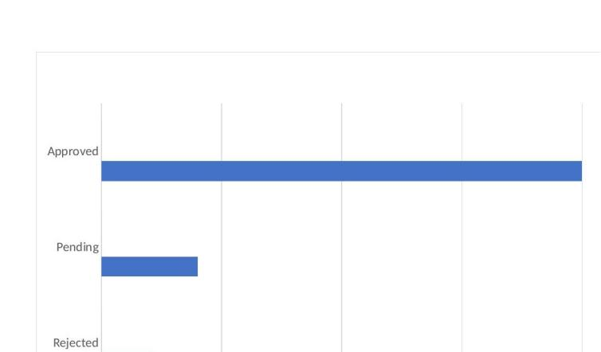
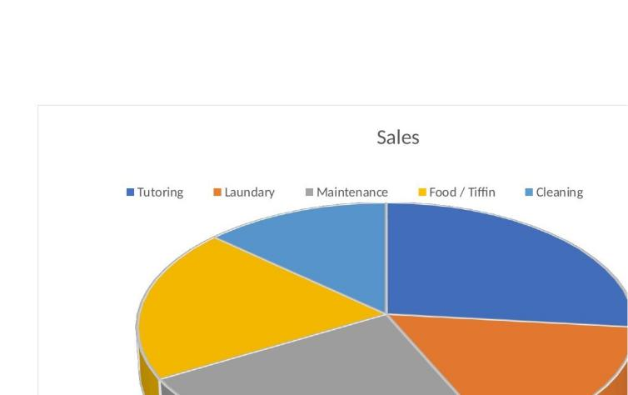
Results
Administrative Approval Workflow
The approval workflow was evaluated to assess the effectiveness of the moderation mechanism. Most submitted services were approved, indicating that users provided relevant and acceptable listings. This reflects well on the submission interface and guidelines. The review process helps maintain quality and ensures only appropriate services are made visible.
Service Category Distribution
The distribution of service categories shows that some services are more commonly used than others. Educational and household services were the most frequent, indicating key community needs. Other categories like food and cleaning were also present, showing the platform supports a variety of everyday services and is flexible for community use.

Slide 11
Key Findings
• Highest Engagement Colony
Colony 1 shows the highest number of users, services, and views, making it the most active community.
• Key Activity Drivers
User participation and service postings are major factors influencing overall engagement.
• Colony Comparison Insight
Colony 2 performs better than Colony 3, showing moderate but consistent activity levels.
• Overall Platform Insight
Higher user involvement leads to increased service usage and better platform engagement across colonies..

Slide 12
Conclusion
MyColony successfully transforms informal colony communication into a structured, secure, and moderated platform
Colonies with higher user participation show greater service interaction and engagement
The platform improves reliability, transparency, and ease of access to hyperlocal services
Demonstrates strong real-world applicability through service discovery, admin monitoring, and community engagement
Built with scalability in mind — ready to expand across multiple colonies and cities

Slide 13
Thank You

